Slide 1
Restricted Boltzman Machines
with
Daniel L. Silver, Ph.D.
Christian Frey, BBA
April 11-12, 2017

Slide 2
Johann von Neumann’s Opinion
“All of this will lead to theories [of computation] which are much less rigidly of an all-or-none nature than past and present a formal logic …. There are numerous indications to make us believe that this new system of formal logic will move closer to another discipline which has been little linked in the past with logic. This is thermodynamics, primarily in the form it was received from Boltzmann, and is that part of theoretical physics which comes nearest in some of its aspects to manipulating and measuring information.”
John Von Neumann, Collected Works, Vol.5, p.304

Slide 3
Boltzmann Machine (BM)
An unsupervised learning system
A type of stochastic recurrent neural network (form of Markov Random Field) invented by Geoffrey Hinton and Terry Sejnowski in 1985
Can be seen as the stochastic, generative counterpart of Hopfield nets
Based on the mathematics of thermodynamics
Complex training algorithm that does not scale well (grows exponential with number of nodes)

Slide 4
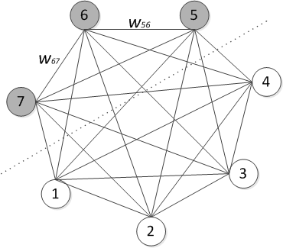
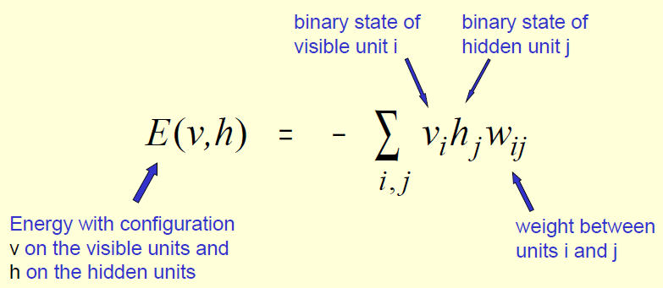
Boltzmann Machine (BM)
BM is a type of stochastic recurrent neural network
All units (neurons) are binary & stochastic
Characteristics
Unsupervised learning
Associative memory
Long training time
Energy function

Slide 5
Restricted Boltzmann Machine (RBM)
A generative stochastic artificial neural network that can learn a probability distribution over its set of inputs.
Restrict connectivity of network
Undirected bipartite graphical model
Restrict number of iterations in + and – phases

Slide 6
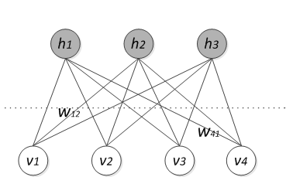
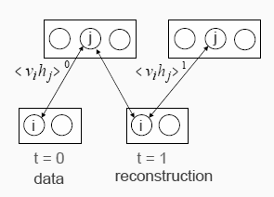
Restricted Boltzmann Machine (RBM)
Does not allow intra-layer connections (bipartite architecture)
Learning both recognition model and generative model

Slide 7
RBM

Slide 8
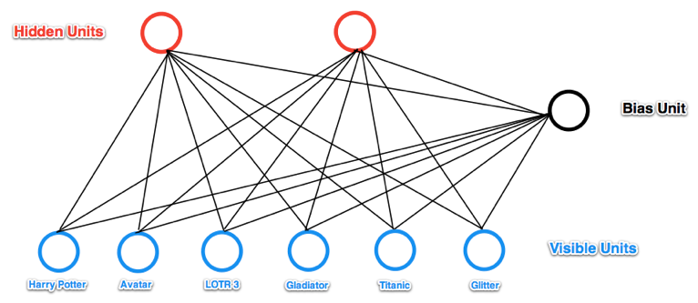
Restricted Boltzman Machine
h_{j}⬅ p_{j}=1/(1-e^{-Σj})
Recall = Relaxation
j
Σ_{j}=w_{ij}v_{i}
w_{ij}
v_{o} or h_{o}
i
Σ_{i}=w_{ij}h_{j}
v_{i}⬅ p_{i}=1/(1-e^{-Σi})
SF/Fantasy
Oscar Winner
Source: http://blog.echen.me/2011/07/18/introduction-to-restricted-boltzmann-machines/

Slide 9
Restricted Boltzman Machine
h_{j}⬅ p_{j}=1/(1-e^{-Σj})
Recall = Relaxation
j
Σ_{j}=w_{ij}v_{i}
w_{ij}
v_{o} or h_{o}
i
Σ_{i}=w_{ij}h_{j}
v_{i}⬅ p_{i}=1/(1-e^{-Σi})
SF/Fantasy
Oscar Winner
Source: http://blog.echen.me/2011/07/18/introduction-to-restricted-boltzmann-machines/

Slide 10
Restricted Boltzman Machine
h_{j}⬅ p_{j}=1/(1-e^{-Σj})
Recall = Relaxation
SF/Fantasy
Oscar Winner
j
Σ_{j}=w_{ij}v_{i}
w_{ij}
v_{o} or h_{o}
i
Σ_{i}=w_{ij}h_{j}
v_{i}⬅ p_{i}=1/(1-e^{-Σi})
SF/Fantasy
Oscar Winner
Source: http://blog.echen.me/2011/07/18/introduction-to-restricted-boltzmann-machines/

Slide 11
Restricted Boltzman Machine
h_{j}⬅ p_{j}=1/(1-e^{-Σj})
Recall = Relaxation
SF/Fantasy
Oscar Winner
j
Σ_{j}=w_{ij}v_{i}
w_{ij}
v_{o} or h_{o}
i
Σ_{i}=w_{ij}h_{j}
v_{i}⬅ p_{i}=1/(1-e^{-Σi})
SF/Fantasy
Oscar Winner
Source: http://blog.echen.me/2011/07/18/introduction-to-restricted-boltzmann-machines/

Slide 12
Restricted Boltzman Machine
h_{j}⬅ p_{j}=1/(1-e^{-Σj})
Learning = ~ Gradient Descent
= Constrastive Divergence
Update hidden units
j
Σ_{j}=w_{ij}v_{i}
P=P+v_{i}h_{j}
v_{o} or h_{o}
i
Σ_{i}=w_{ij}h_{j}
v_{i}⬅ p_{i}=1/(1-e^{-Σi})
SF/Fantasy
Oscar Winner
Source: http://blog.echen.me/2011/07/18/introduction-to-restricted-boltzmann-machines/

Slide 13
Restricted Boltzman Machine
h_{j}⬅ p_{j}=1/(1-e^{-Σj})
Learning = ~ Gradient Descent
= Constrastive Divergence
Reconstruct visible units
j
Σ_{j}=w_{ij}v_{i}
v_{o} or h_{o}
i
Σ_{i}=w_{ij}h_{j}
v_{i}⬅ p_{i}=1/(1-e^{-Σi})
SF/Fantasy
Oscar Winner
Source: http://blog.echen.me/2011/07/18/introduction-to-restricted-boltzmann-machines/

Slide 14
Restricted Boltzman Machine
h_{j}⬅ p_{j}=1/(1-e^{-Σj})
Learning = ~ Gradient Descent
= Constrastive Divergence
Reupdate hidden units
j
Σ_{j}=w_{ij}v_{i}
N=N+v_{i}h_{j}
v_{o} or h_{o}
i
Σ_{i}=w_{ij}h_{j}
v_{i}⬅ p_{i}=1/(1-e^{-Σi})
SF/Fantasy
Oscar Winner
Source: http://blog.echen.me/2011/07/18/introduction-to-restricted-boltzmann-machines/

Slide 15
Restricted Boltzman Machine
h_{j}⬅ p_{j}=1/(1-e^{-Σj})
Learning = ~ Gradient Descent
= Constrastive Divergence
Update weights
j
Σ_{j}=w_{ij}v_{i}
w_{ij}=w_{ij} +ηΔw_{ij}
Δw_{ij}=<P>-<N>
v_{o} or h_{o}
i
Σ_{i}=w_{ij}h_{j}
v_{i}⬅ p_{i}=1/(1-e^{-Σi})
SF/Fantasy
Oscar Winner
Source: http://blog.echen.me/2011/07/18/introduction-to-restricted-boltzmann-machines/

Slide 16
Why does this weight update agorithm work?
In the first phase, v_{i}h_{j} measures the association between the i^{th} and j^{th} unit that we want the network to learn from our training examples
In the “reconstruction” phase, where the RBM generates the states of visible units based on its hypotheses about the hidden units alone, v_{i}h_{j} measures the association that the network itself generates (or “daydreams” about) when no units are fixed to training data
So by adding <P>-<N> to each weight, we are helping the network’s daydreams better match the reality of our training examples
This performs an approximate gradient descent on the derivative of the reconstruction error with respect to the weights

Slide 17
Multi-modal Deep Learning
8
eight

Slide 18
Multi-modal Deep Learning
DEMO
8
eight

Slide 19
Restricted Boltzman Machine
RBM Overview:
http://blog.echen.me/2011/07/18/introduction-to-restricted-boltzmann-machines/
Wikipedia on DLA and RBM:
http://en.wikipedia.org/wiki/Deep_learning
RBM Details and Code:
http://www.deeplearning.net/tutorial/rbm.html

Slide 20
Restricted Boltzman Machine
Geoff Hinton on RBMs:
RBMs and Constrastive Divergence Algorithm
http://www.youtube.com/watch?v=fJjkHAuW0Yk
An example of RBM Learning
http://www.youtube.com/watch?v=Ivj7jymShN0
RBMs applied to Collaborative Filtering
http://www.youtube.com/watch?v=laVC6WFIXjg

Slide 21
Additional References
Coursera course – Neural Networks fro Machine Learning:
https://class.coursera.org/neuralnets-2012-001/lecture
ML: Hottest Tech Trend in next 3-5 Years
http://www.youtube.com/watch?v=b4zr9Zx5WiE

Slide 22
TUTORIAL 6
Develop and train a RBM network (Python code)
Notes:
Rbm.py

