Slide 1
Recurrent Neural Networks
with
Daniel L. Silver, Ph.D.
Christian Frey, BBA
April 11-12, 2017
Slides based on originals by Yann LeCun

Slide 2
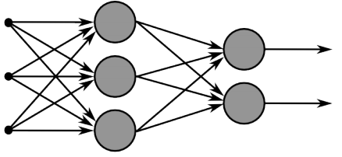
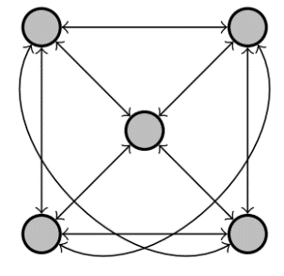
Recurrent Neural Networks
Multi-layer feed-forward NN: DAG
Just computes a fixed sequence of
non-linear learned transformations to convert an input patter into an output pattern
Recurrent Neural Network: Digraph
Has cycles.
Cycle can act as a memory;
The hidden state of a recurrent net can carry along information about a “potentially” unbounded number of previous inputs.
They can model sequential data in a much more natural way.

Slide 3
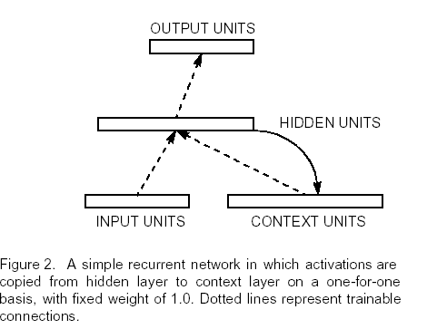
Simple Recurrent Neural Networks (Elman)

Slide 4
Short-term memory in RNN
The context units remember the previous internal state.
Thus, the hidden units have the task of mapping both an external input and also the previous internal state to some desired output.
An RNN can predict the next item in a sequence from the current and preceding input.

Slide 5
Equivalence between RNN and Feed-forward NN
Assume that there is a time delay of 1 in using each connection.
The recurrent net is just a layered net that keeps reusing the same weights.
time=3
W1 W2 W3 W4
w1 w4
time=2
W1 W2 W3 W4
w2 w3
time=1
W1 W2 W3 W4
time=0
Slide Credit: Geoff Hinton

Slide 6
Recurrent Neural Networks
Training a general RNN’s can be hard
Here we will focus on a special family of RNN’s
Prediction on chain-like input:
Example: POS tagging words of a sentence
Issues :
Structure in the output: There is connections between labels
Interdependence between elements of the inputs: The final decision is based on an intricate interdependence of the words on each other.
Variable size inputs: e.g. sentences differ in size
How would you go about solving this task?
$X=$ This is a sample sentence .
Y$=$ DT VBZ DT NN NN .

Slide 7
Recurrent Neural Networks

Slide 8
Recurrent Neural Networks
A chain RNN:
Has a chain-like structure
Each input is replaced with its vector representation $x_{t}$
Hidden (memory) unit $h_{t}$ contain information about previous inputs and previous hidden units $h_{t−1},h_{t−2},$ etc
Computed from the past memory and current word. It summarizes the sentence up to that time.
$x_{t−1}$ $x_{t}$ $x_{t+1}$
O O O O O
O O O O O
O O O O O
Input layer
O O O O O
O O O O O
O O O O O
Memory layer
$h_{t−1}$ $h_{t}$ $h_{t+1}$

Slide 9
Recurrent Neural Networks
A popular way of formalizing it:
$$h_{t}=f(W_{h}h_{t−1}+W_{i}x_{t})$$
Where $f$ is a nonlinear, differentiable function.
Outputs?
Many options; depending on problem and computational resource (sigmoid for regression, softmax for classification)
$x_{t−1}$ $x_{t}$ $x_{t+1}$
O O O O O
O O O O O
O O O O O
O O O O O
O O O O O
O O O O O
$h_{t−1}$ $h_{t}$ $h_{t+1}$

Slide 10
Recurrent Neural Networks
Prediction for $x_{t}$, with $h_{t}$
Prediction for $x_{t}$, with $h_{t},{…, h}_{t−τ}$
Prediction for the whole chain
Some inherent issues with simple RNNs:
RNNs often capture too much of last words in final vector
$$y_{t}=softmax\left(W_{o}h_{t} \right)$$
$$y_{t}=softmax\left(\sum_{i=0}^{τ}{α^{i}{W_{o}^{}}^{−i}h_{t−i}}\right)$$
$$y_{T}=softmax\left(W_{o}h_{T} \right)$$
$x_{t−1}$ $x_{t}$ $x_{t+1}$
O O O O O
O O O O O
O O O O O
O O O O O
O O O O O
O O O O O
$h_{t−1}$ $h_{t}$ $h_{t+1}$
$y_{t−1}$ $y_{t}$ $y_{t+1}$

Slide 11
Bi-directional RNN
One of the issues with RNN:
Hidden variables capture only one side of context
A bi-directional structure
$x_{t−1}$ $x_{t}$ $x_{t+1}$
O O O O O
O O O O O
O O O O O
$$h_{t}=f(W_{h}h_{t−1}+W_{i}x_{t})$$
$h_{t−1}$ $h_{t}$ $h_{t+1}$
$${\tilde{h}}_{t}=f({\tilde{W}}_{h}{\tilde{h}}_{t+1}+{\tilde{W}}_{i}x_{t})$$
$$y_{t}=softmax\left(W_{o}h_{t}+{\tilde{W}}_{o}{\tilde{h}}_{t}\right)$$
O O O O O
O O O O O
O O O O O
O O O O O
O O O O O
O O O O O
${\tilde{h}}_{t−1}$ ${\tilde{h}}_{t}$ ${\tilde{h}}_{t+1}$
$y_{t−1}$ $y_{t}$ $y_{t+1}$

Slide 12
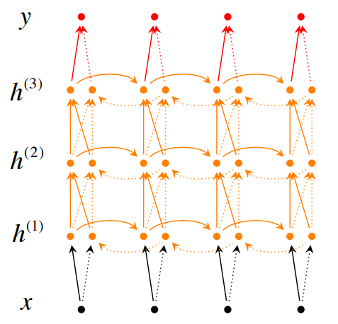
Stack of bi-directional networks
Use the same idea and make your model further complicated:

Slide 13

Training RNNs
How to train such model?
Generalize the same ideas from back-propagation
Total output error: $E\left(\vec{y}, \vec{t}\right)=\sum_{t=1}^{T}{E_{t}\left(y_{t}{, t}_{t}\right)}$
Parameters?
$W_{o}$, $W_{i}$, $W_{h}$ +
vectors for input
$$\frac{∂E}{∂W}=\sum_{t=1}^{T}{\frac{∂E_{t}}{∂W}}$$
Reminder:
$$y_{t}=softmax\left(W_{o}h_{t} \right)$$
$$h_{t}=f(W_{h}h_{t−1}+W_{i}x_{t})$$
$$\frac{∂E_{t}}{∂W}=\sum_{t=1}^{T}{\frac{∂E_{t}}{∂y_{t}}\frac{∂y_{t}}{∂h_{t}}\frac{∂h_{t}}{∂h_{t−k}}\frac{∂h_{t−k}}{∂W}}$$
Backpropagation for RNN
This sometimes is called “Backpropagation Through Time”, since the gradients are propagated back through time.
$x_{t−1}$ $x_{t}$ $x_{t+1}$
O O O O O
O O O O O
O O O O O
O O O O O
O O O O O
O O O O O
$h_{t−1}$ $h_{t}$ $h_{t+1}$
$y_{t−1}$ $y_{t}$ $y_{t+1}$

Slide 14

Recurrent Neural Network
$$\frac{∂E}{∂W}=\sum_{t=1}^{T}{\frac{∂E_{t}}{∂y_{t}}\frac{∂y_{t}}{∂h_{t}}\frac{∂h_{t}}{∂h_{t−k}}\frac{∂h_{t−k}}{∂W}}$$
Reminder:
$$y_{t}=softmax\left(W_{o}h_{t} \right)$$
$$h_{t}=f(W_{h}h_{t−1}+W_{i}x_{t})$$
$$\frac{∂h_{t}}{∂h_{t−1}}=W_{h}diag\left[f^{′}(W_{h}h_{t−1}+W_{i}x_{t})\right]$$
$$diag\left[a_{1}, …, a_{n}\right]=\left[\begin{matrix}a_{1} & 0 & 0 \\ 0 & ⋱ & 0 \\ 0 & 0 & a_{n}\end{matrix}\right]$$
$$\frac{∂h_{t}}{∂h_{t−k}}=\prod_{j=t−k+1}^{t}{\frac{∂h_{j}}{∂h_{j−1}}}=\prod_{j=t−k+1}^{t}{W_{h}diag\left[f^{′}(W_{h}h_{t−1}+W_{i}x_{t})\right]}$$
Backpropagation for RNN
$x_{t−1}$ $x_{t}$ $x_{t+1}$
O O O O O
O O O O O
O O O O O
O O O O O
O O O O O
O O O O O
$h_{t−1}$ $h_{t}$ $h_{t+1}$
$y_{t−1}$ $y_{t}$ $y_{t+1}$

Slide 15
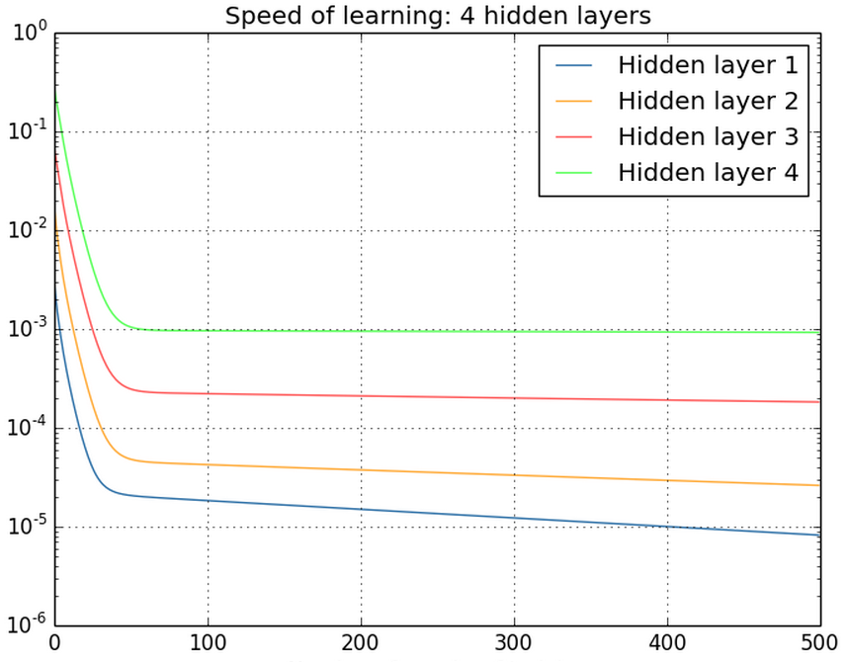
Vanishing/exploding gradients
$$\frac{∂h_{t}}{∂h_{t−k}}=\prod_{j=t−k+1}^{t}{W_{h}diag\left[f^{′}(W_{h}h_{t−1}+W_{i}x_{t})\right]}$$
Vanishing gradients are quite prevalent and a serious issue.
A real example
Training a feed-forward network
y-axis: sum of the gradient norms
Earlier layers have exponentially
smaller sum of gradient norms
This will make training earlier
layers much slower.
$$\frac{∂h_{t}}{∂h_{k}}≤\prod_{j=t−k+1}^{t}{\left\|W_{h}\right\|\left\|diag\left[f^{′}(W_{h}h_{t−1}+W_{i}x_{t})\right]\right\|≤\prod_{j=t−k+1}^{t}{αβ=}{\left(αβ\right)}^{k}}$$
Gradient can become very small or very large quickly, and the locality assumption of gradient descent breaks down (Vanishing gradient) [Bengio et al 1994]

Slide 16
Vanishing/exploding gradients

Slide 17

Vanishing/exploding gradients
In an RNN trained on long sequences (e.g. 100 time steps) the gradients can easily explode or vanish.
So RNNs have difficulty dealing with long-range dependencies.
Many methods proposed for reduce the effect of vanishing gradients; although it is still a problem
Introduce shorter path between long connections
Abandon stochastic gradient descent in favor of a much more sophisticated Hessian-Free (HF) optimization
Add fancier modules that are robust to handling long memory; e.g. Long Short Term Memory (LSTM)
One trick to handle the exploding-gradients:
Clip gradients with bigger sizes:
Defnne $g=\frac{∂E}{∂W}$
If $\left\|g\right\|≥threshold$ then
$g←\frac{threshold}{\left\|g\right\|}g$

Slide 18
Vanishing/exploding gradients
Long Short Term Memory Make the RNN out of little modules that are designed to remember values for a long time.
Hessian Free Optimization: Deal with the vanishing gradients problem by using a fancy optimizer that can detect directions with a tiny gradient but even smaller curvature.
The HF optimizer ( Martens & Sutskever, 2011) is good at this.
Echo State Networks: Initialize the input→hidden and hidden→hidden and output→hidden connections very carefully so that the hidden state has a huge reservoir of weakly coupled oscillators which can be selectively driven by the input.
ESNs only need to learn the hidden→output connections.
Good initialization with momentum Initialize like in Echo State Networks, but then learn all of the connections using momentum.

Slide 19
Long Short Term Memory (LSTM)
Hochreiter & Schmidhuber (1997) solved the problem of getting an RNN to remember things for a long time (like hundreds of time steps).
Key idea is that information from the distant past can be retained if important to model
They designed a memory cell using logistic and linear units with multiplicative interactions
Information gets into the cell whenever its “write” gate is on.
The information stays in the cell so long as its “keep” gate is on.
Information can be read from the cell by turning on its “read” gate.

Slide 20
A neural network with memory
keep gate
To preserve information for a long time in the activities of an RNN, we use a circuit that implements an analog memory cell.
A linear unit that has a self-link with a weight of 1 will maintain its state.
Information is stored in the cell by activating its write gate.
Information is retrieved by activating the read gate.
We can backpropagate through this circuit because logistics are have nice derivatives.
1.73
write gate
read gate
input from rest of RNN
output to rest of RNN

Slide 21
Cell state vector provides
the memory of values from prior time steps

Slide 22
TUTORIAL 9
Develop and train a LSTM network using Keras and Tensorflow (Python code)
Notes:
Rbm.py

Slide 23
References
Christopher Olah’s Blog
http://colah.github.io/
http://colah.github.io/posts/2015-08-Understanding-LSTMs/

Slide 24
A good toy problem for a recurrent network
We can train a feedforward net to do binary addition, but there are obvious regularities that it cannot capture efficiently.
We must decide in advance the maximum number of digits in each number.
The processing applied to the beginning of a long number does not generalize to the end of the long number because it uses different weights.
As a result, feedforward nets do not generalize well on the binary addition task.
11001100
hidden units
00100110
10100110

Slide 25
The algorithm for binary addition
1 0
0 1
0 0
carry print 1
1 1
no carry print 1
0 0
1 0
0 1
0 0
1 1
1 0
0 1
1 1
no carry print 0
carry print 0
0 0
1 1
0 1
1 0
This is a finite state automaton. It decides what transition to make by looking at the next column. It prints after making the transition. It moves from right to left over the two input numbers.

Slide 26
A recurrent net for binary addition
The network has two input units and one output unit.
It is given two input digits at each time step.
The desired output at each time step is the output for the column that was provided as input two time steps ago.
It takes one time step to update the hidden units based on the two input digits.
It takes another time step for the hidden units to cause the output.
0 0 1 1 0 1 0 0
0 1 0 0 1 1 0 1
1 0 0 0 0 0 0 1
time

Slide 27
The connectivity of the network
The 3 hidden units are fully interconnected in both directions.
This allows a hidden activity pattern at one time step to vote for the hidden activity pattern at the next time step.
The input units have feedforward connections that allow then to vote for the next hidden activity pattern.
3 fully interconnected hidden units

Slide 28
What the network learns
It learns four distinct patterns of activity for the 3 hidden units. These patterns correspond to the nodes in the finite state automaton.
Do not confuse units in a neural network with nodes in a finite state automaton. Nodes are like activity vectors.
The automaton is restricted to be in exactly one state at each time. The hidden units are restricted to have exactly one vector of activity at each time.
A recurrent network can emulate a finite state automaton, but it is exponentially more powerful. With N hidden neurons it has 2^N possible binary activity vectors (but only N^2 weights)
This is important when the input stream has two separate things going on at once.
A finite state automaton needs to square its number of states.
An RNN needs to double its number of units.

